Slide 1
Towards an innovative and collaborative refurbishment ecosystem for Europe
Logo
Name of the presenter:
Organisation:
This project has received funding from the European Union’s Horizon 2020 research and innovation programme under grant agreement 768623.

Slide 2
WHAT IS REZBUILD PROJECT OBJECTIVES TECHNOLOGIES DEMO BUILDINGS SCENARIOS PUBLIC PARTICIPATION EDUCATION AND TRAINING WORK PLAN CONSORTIUM

Slide 3
WHAT IS REZBUILD PROJECT

Slide 4
WHAT IS REZBUILD PROJECT
The REZBUILD project grows with the main aim of defining a collaborative refurbishment ecosystem focused on the existing residential building stock. Nowadays, the Near Zero Energy Building (NZEB) renovation methodologies are required as one of the key enablers supported by Horizon 2020 Framework Programme in order to promote business research and innovation through energy-efficient buildings.
This project is awarded by the European Commission through a H2020 programme Grant of € 6,996,128.25 and a total budget of € 9,038,208.75. REZBUILD started in October 2017 and will run for 4 years.
logo

Slide 5
OBJETIVES

Slide 6
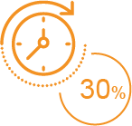
ENERGY REDUCTION
OBJETIVES
A reduced installation at least a 30% of time saving in time in comparison with a traditional refurbishment work
TIME SAVING
A deep renovation rate at least 60% of primary energy reduction as a result, the application of a decision tree strategy born from the combination of shared principles of the modern sustainable architecture and NZEB design concepts
A rapid payback period maximum 12 years of the best retrofitting technology package installed in the residential building.
RAPID PAYBACK
logo

Slide 7
TECHNOLOGIES

Slide 8
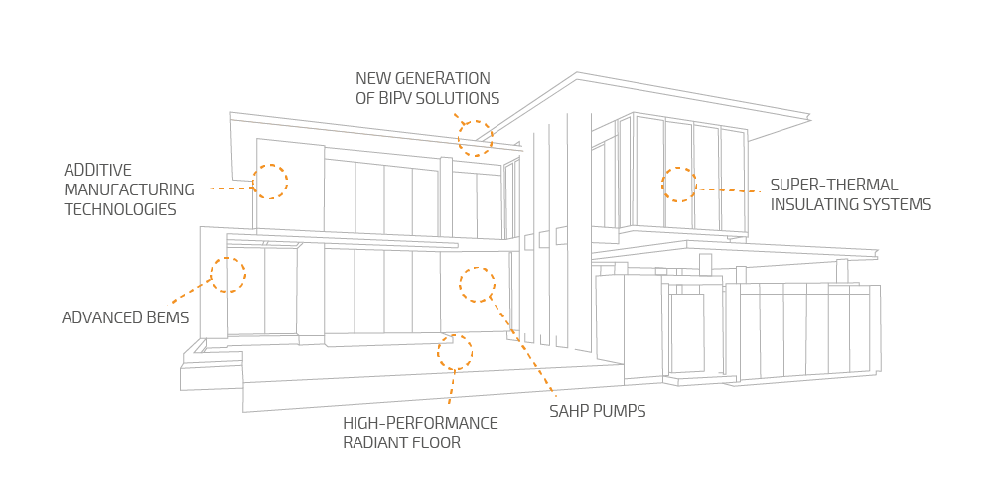
TECHNOLOGIES
logo

Slide 9
DEMO BUILDINGS SCENARIOS

Slide 10
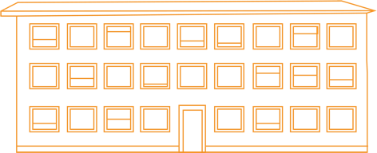
DEMO BUILDINGS SCENARIOS
SINGLE-FAMILY BUILDING LOCATED IN MADRID (SPAIN)
The dwelling selected for the demonstration is a semi-detached house, representing typical single familiar dwellings in different districts in the Community of Madrid.
TERRACED HOUSE BUILDING LOCATED IN VENICE (ITALY)
The dwelling selected for the demonstration is a two stories terrace house
APPARTMENT BLOCK BUILDING LOCATED IN OSLO (NORWAY)
The dwelling selected for the demonstration is a housing cooperative, representing typical dwellings in Norway.
logo

Slide 11
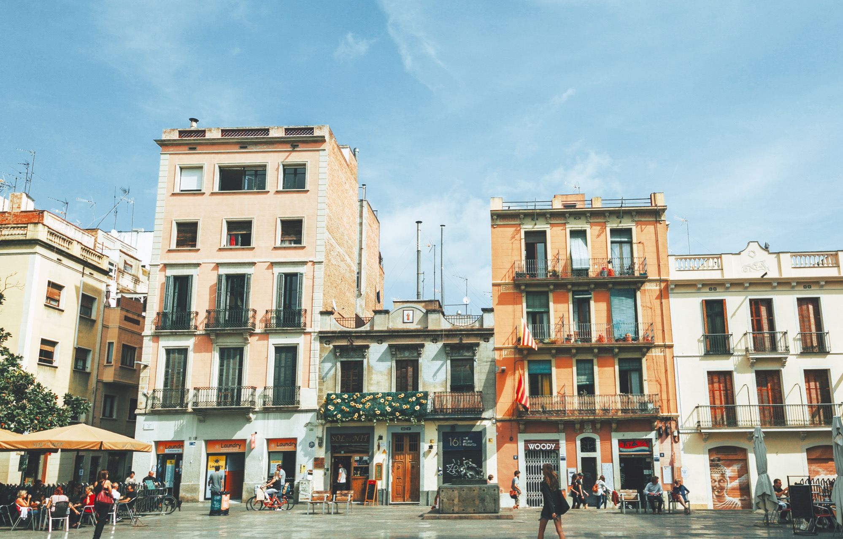
PUBLIC PARTICIPATION

Slide 12
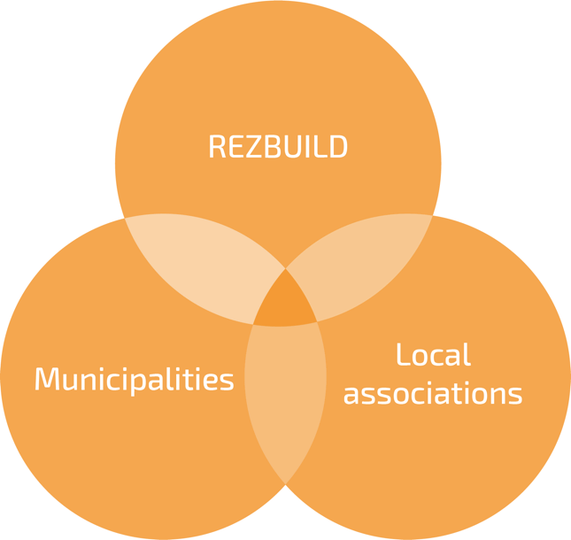
PUBLIC PARTICIPATION
PARTICIPATIVE PROCESSES
“Participation is a way of viewing the world and acting in it. It is about a commitment to help create the conditions which lead to significant empowerment of those who at present have little control over the forces that condition their lives”
Marjorie Mbilinyi and Rakesh Rayani Research and Social Action with the Grassroots
logo

Slide 13
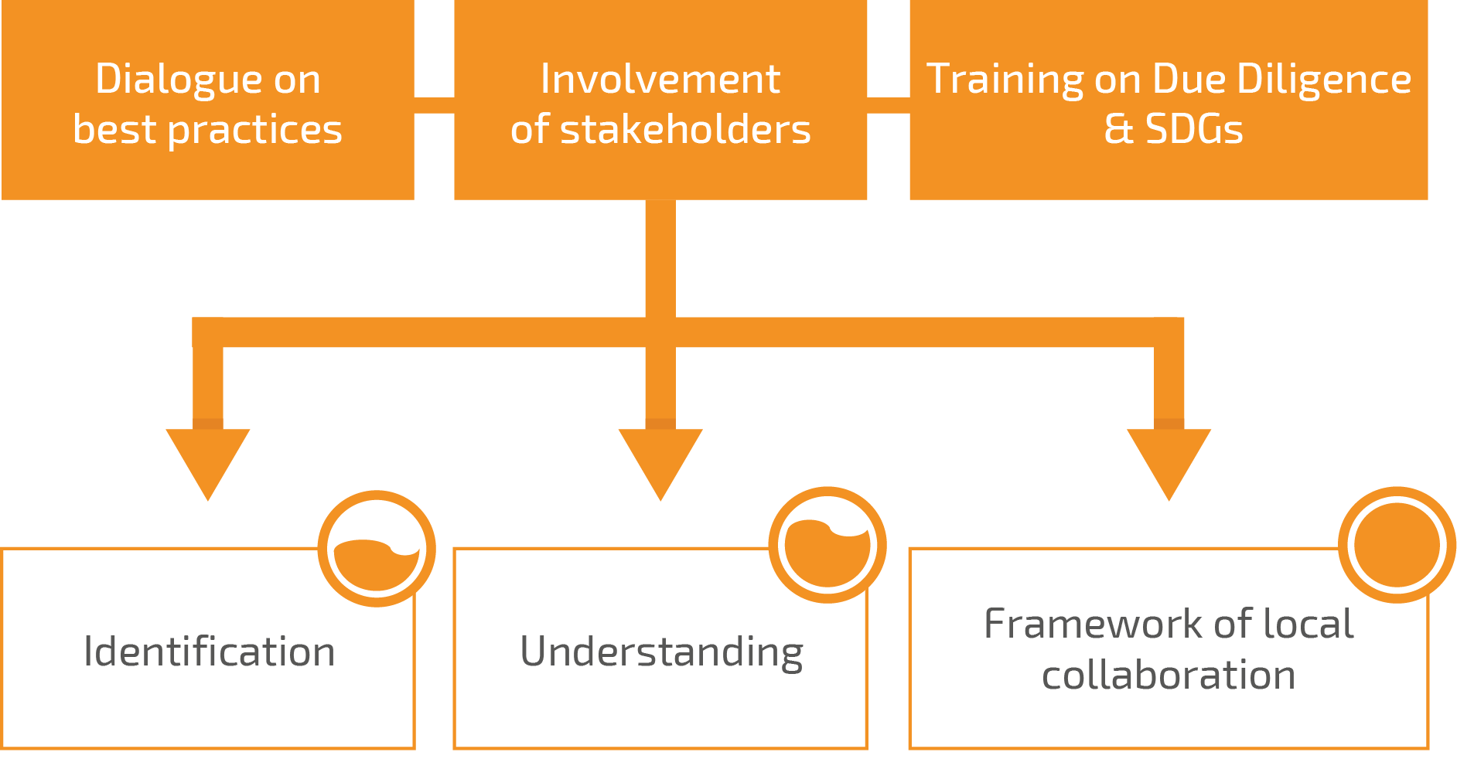
PUBLIC PARTICIPATION
What?
Methodology for decision making processes which involves all the stakeholders
Why?
Involve all the relevant expertise in the process: “people are experts in their life”
When?
Before, during and after the implementation of the project/measure
Who?
All the stakeholders involved: Local Communities Private sector Local authorities/ policy makers
Where?
Local level
logo

Slide 14
EDUCATION AND TRAINING

Slide 15
EDUCATION AND TRAINING
REZBUILD aims at delivering effective training and education programme for industrialists (especially, SMEs), research infrastructures, as well as to non-specialists to enable the uptake of technologies. Skills and knowledge will be imparted through the structured and hands-on demonstrations around the REZBUILD solutions within the 3 demo sites of the project.
The delivery of the training programme will be carried out through a holistic combination between traditional approaches (such as workshops or e-learning material) and information shared on dedicated knowledge exchange spaces as Energy Education facilities open to the Engineering and PhD students, but also through R&D collaboration programmes / research networks (e.g. Marie-Curie, ITNs, etc.). In addition, the project will provide a set of new training methods (serious games, gamification or ICT tools) to improve the learning process of the participants.
logo

Slide 16
WORK PLAN

Slide 17
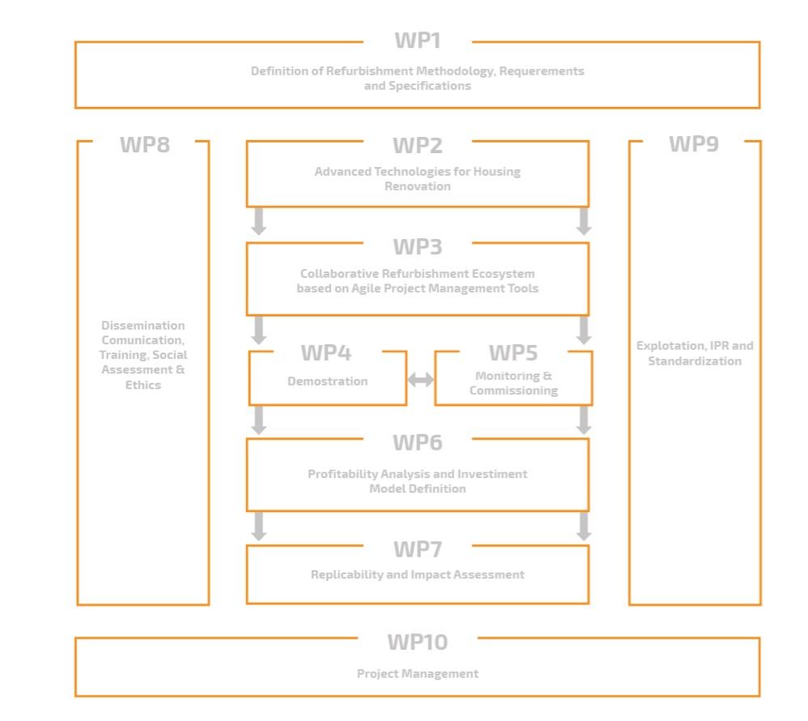
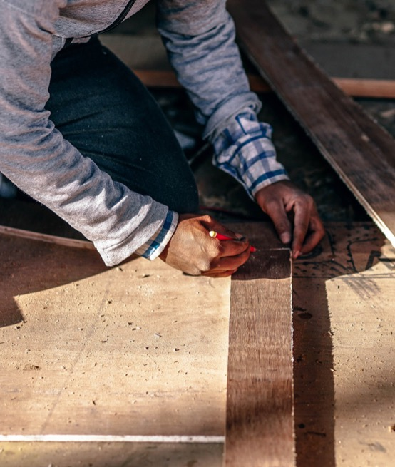
WORK PLAN
logo

Slide 18
CONSORTIUM
OVERDI will be the coordinator of REZBUILD, leading the project management activities, as well as the interaction with the EC (WP10). OVERDI will also lead on performances monitoring (WP5), profitability analysis and investment model definition (WP6). In WP1 OVERDI will support the definition of technical and financial KPIs as well as of LCC indicators.
Maetrics IoT brings solutions for the energy management, smart building and infrastructure to a new level. The firm’s engineering and energy optimization services are developed based on the sustainability of each deployment.
logo

Slide 19
As Construction expert, VIAS will lead the development of the façade 3DP (WP2) and WP1, WP4. VIAS will also be responsible for the standardization assessment (T9.3.). Having a leading role from a technical point of view, VIAS will chair the Project Office, providing technical support to the coordinator.
CARTIF will lead WP2 thanks to its experience in a wide range of industrial fields. During WP2, CARTIF will collaborate with VIAS in the development of the 3DP technology. CARTIF will also be responsible for LCA.
ESTIA will lead the development of the BIM Ecosystem (WP3) providing its experience in control software and data management. ESTIA will collaborate with VIAS in the development of the 3DP technology (ST2.1.1) and will be the main responsible of the BEMs development (T2.4). Additionally, ESTIA will also lead T2.1 and T6.1, and will be in charge of IPR (T9.2) and DMP (WP3).
logo

Slide 20
CTVI together with VIAS will be in charge of the implementation of the Spanish demonstration. In T5.3 CTVI will be in charge of the organisation of the global demonstrator, collecting information on performance, and gathering the monitored results for the related statistical analysis. As regional government, CTVI will be crucial for the user-engagement.
PLACO will have a leading role in both insulation and envelope technologies development phase (ST2.1.3.). They will also collaborate in the tasks related to the compiling and processing data for the BIM Ecosystem within their expertise field, regarding insulation and modular prefabricated systems.
As one of the key technology providers and technical expert in BIPV, ONYX will have a very relevant role on WP2 where they will lead the BIPV development, and the T2.3.
logo

Slide 21
SINTEF will lead WP7 contributing with experience within the areas of evaluation methodologies and technology transfer. SINTEF will also be involved in Demo Scenario 2, which will be settled in Norway, and will lead the definition of the training and education program within WP8.
OBOS main contribution will be in WP4, providing a rehabilitation project as Demo Scenario 2. OBOS will also provide with a powerful platform for the exploitation and dissemination of results. Additionally, on its role of users association, it will have a relevant role on end-user engagement.
UNOTT will lead energy simulation and modelling (T3.1) and will develop and advanced SAHP in WP2. UNOTT will also contribute to WP4 and WP5. In addition, as academia partner, UNOTT will also contribute to the dissemination, training & social assessment tasks (WP8).
logo

Slide 22
As a technology provider and HVAC expert, EXPLODED will develop the advance HVAC systems by radiative floors (WP2). Data collection and management is an intricate part of their systems, thus they will also collaborate in WP5.
RIMOND will lead the BIM development (WP2, WP3). At a later time it will collaborate with VERDI on the design development of the Italian Demo.
ZABALA will lead WP8 and WP9. ZABALA will chair the Project Secretary (WP10), supporting VERDI in project management, administrative and documental tasks, and financial control.
logo

Slide 23
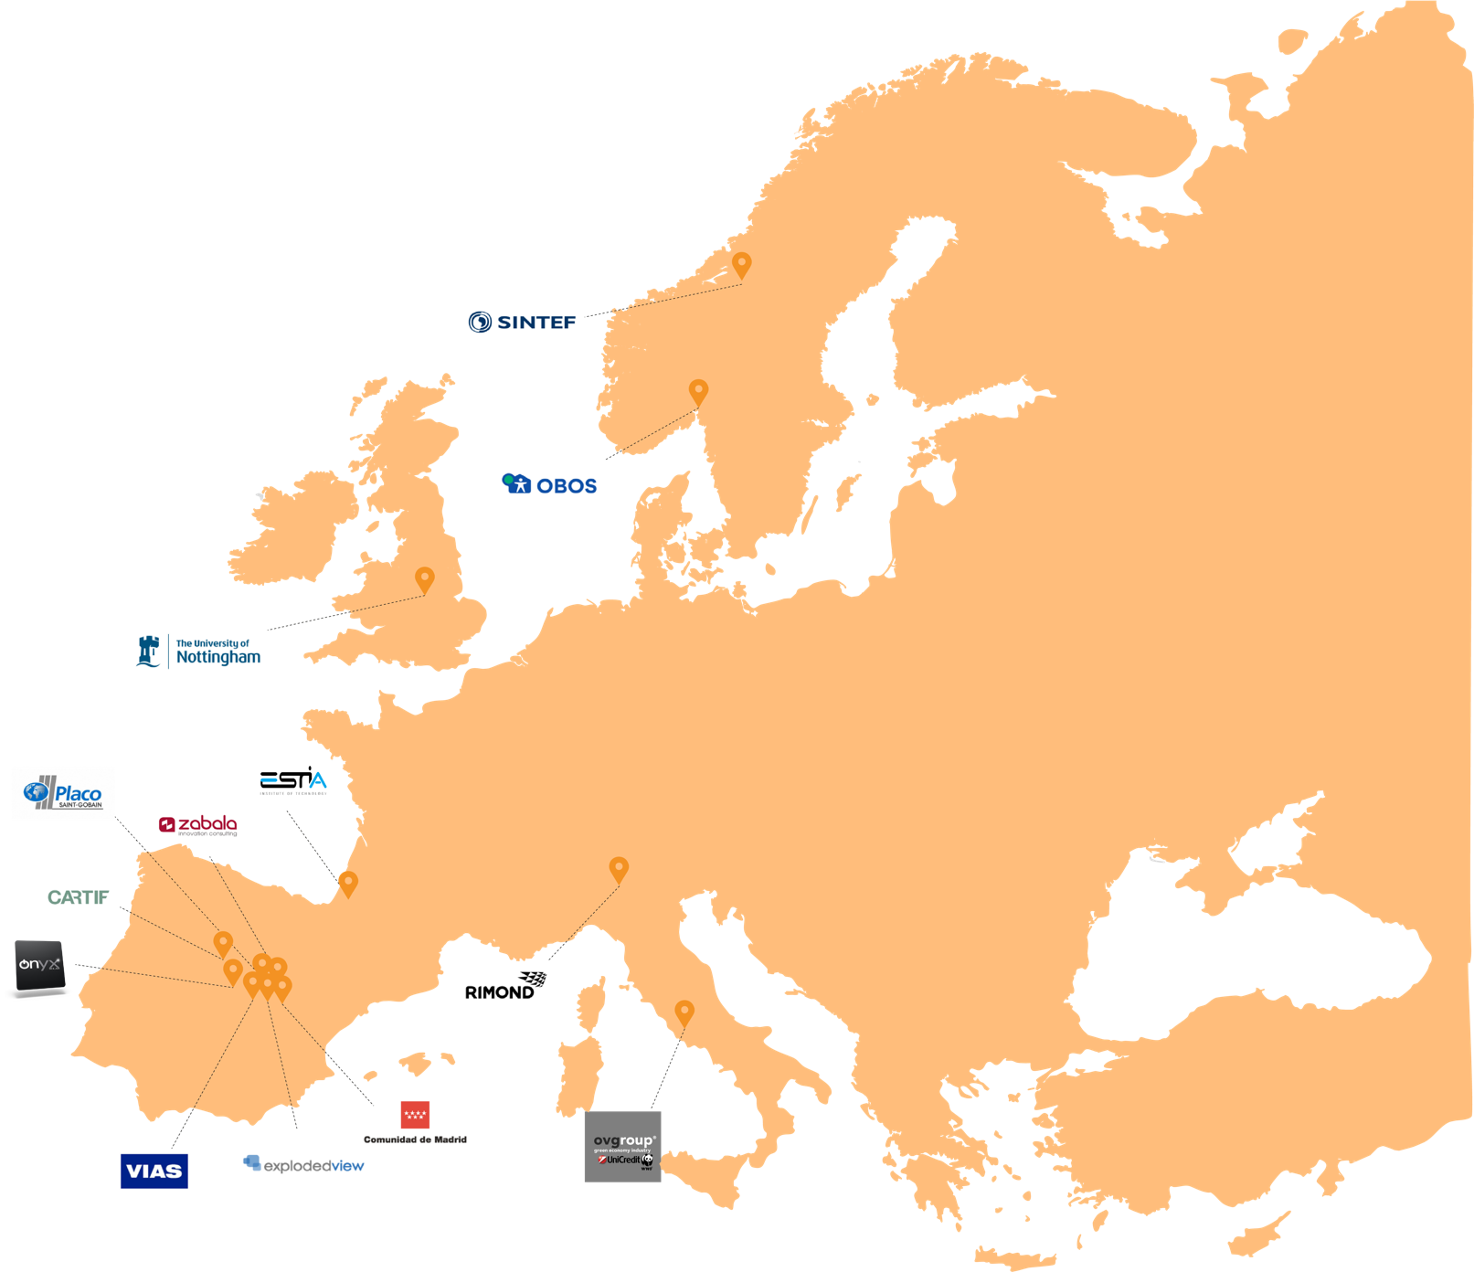
Who is involved?
REZBUILD consortium brings together 14 Partners from 5 different countries.
Coordinator:
OVERDI
E-mail: a.cassisi@ovaerdi.com
logo

Slide 24
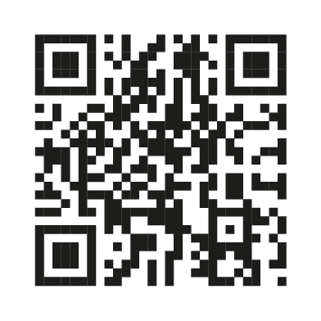
www.rezbuildproject.eu
Subscribe to our newsletter and keep up to date with the latest news
We appreciate your feedback!
logo

